Slide 1
A Target for Refactoring
by
Rochelle
Chamila

Slide 2
Design Pattern helps
to recognize a design
reduce the amount of refactoring you need to do later

Slide 3
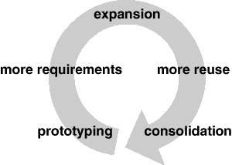
Life cycle of object oriented software – according to Brian Foote
Prototyping
Expansionary
Consolidating

Slide 4
Prototyping
Is bringing the software to life to meet the requirements. In this stage the software is expected to have class hierarchies.
a flurry of activities
Software is brought to life through rapid prototyping and incremental changes
After reaching the adolescence, Software usually consist of class hierarchies that closely reflects entities in the initial problem domain.
The main kind of reuse is white box reuse by inheritance.

Slide 5
Expansion
The software must satisfy more requirements
The software must be more reusable
This phase shouldn’t carry on for too long
Can cause the software to be inflexible – if too much expansion
Class hierarchies will no longer match any problem

Slide 6
Consolidatinon
Is about how the software must be reorganised – refactored.
This is where black box reuse replaces white box reuse because new kinds of objects are made from moving functionality around and changing the class hierarchy.

Slide 7
Refactoring / Consolidation
involves tearing apart classes into special and general purpose components,
Moving operations up or down the class hierarchies
Rationalizing the interfaces of classes
Produce new kinds of objects
Decompose existing objects
Expansion and Consolidation phases are repeated a lot as requirements make the software bigger and the refactoring makes the software more general.

Slide 8
Good designers
Aware of changes that can prompt refactoring
Aware of class and object structure that can help avoid refactoring
Their designs are robust in the face of requirements changes

Slide 9
Conclusion
Design patterns capture many of the structures that result from refactoring
Using these patterns early in design prevents later refactoring.
Design patterns can show you how to change the system
Design patterns provide targets for your refactoring's even if you don’t see how to apply the pattern correctly until afterwards the system is built.

